Slide 1
Lecture 5
Signals and Systems (ELL205)
By Dr. Abhishek Dixit
Dept. of Electrical Engineering
IIT Delhi

Slide 2
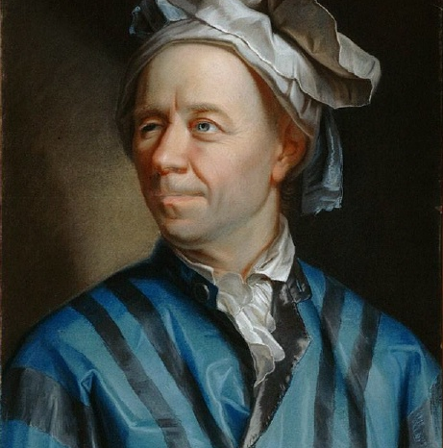
Leonhard Euler
(15 April 1707 – 18 September 1783) was a Swiss mathematician.
His collected works is about 900 research papers, more than anybody in the field.
In 1766, he got completely blind, and then he quoted “now I have a fewer distractions.”
After that he produced almost one mathematical paper every week.
He had two wives. The second of whom he took at the age 69. He had 13 children.

Slide 3
Outline
Signal transformations
Classifications of Signals
Basic Signals (DT)
  Exponential
  Unit-step
  Unit-impulse

Slide 4
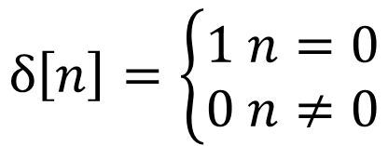
Unit-impulse
$$δ\left[n\right]=\left\{\begin{aligned}1 n=0 \\ 0 n≠0\end{aligned}\right.$$
Unit-sample or Kronecker delta

Slide 5
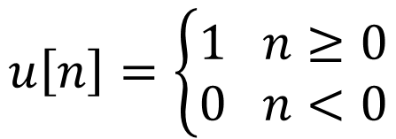
Unit-step
$$u\left[n\right]=\left\{\begin{aligned}1 n≥0 \\ 0 n<0\end{aligned}\right.$$

Slide 6



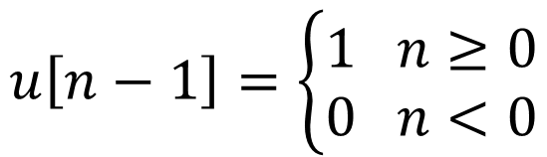

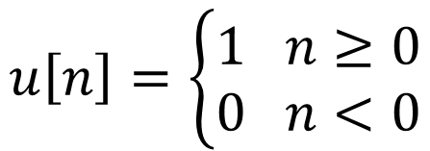









Unit-step
$$u\left[n\right]=\left\{\begin{aligned}1 n≥0 \\ 0 n<0\end{aligned}\right.$$
$$0$$
$$1$$
$$2…$$
$$n$$
$$u\left[n−1\right]=\left\{\begin{aligned}1 n≥0 \\ 0 n<0\end{aligned}\right.$$
$$0$$
$$1$$
$$2…$$
$$n$$
$$δ\left[n\right]=u\left[n\right]−u\left[n−1\right]$$
$$0$$
$$1$$
$$2…$$
$$n$$

Slide 7
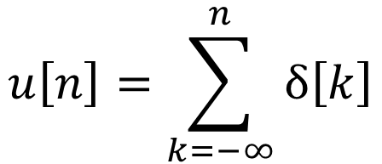
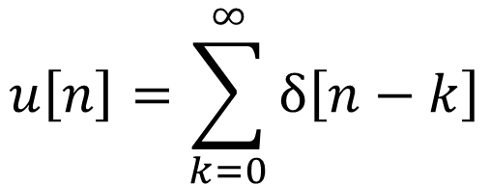

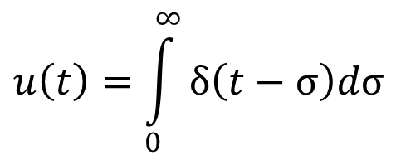
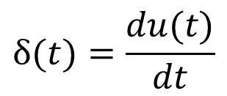
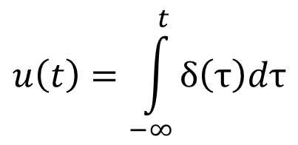
Unit-step
$$δ(t)=\frac{du(t)}{dt}$$
$$δ\left[n\right]=u\left[n\right]−u\left[n−1\right]$$
$$u\left[n\right]=\sum_{k=−∞}^{n}{δ\left[k\right]}$$
$$u\left(t\right)=\int_{−∞}^{t}{δ\left(τ\right)dτ}$$
$$u\left[n\right]=\sum_{k=0}^{∞}{δ\left[n−k\right]}$$
$$u\left(t\right)=\int_{0}^{∞}{δ\left(t−σ\right)dσ}$$

Slide 8
Outline
Signal transformations
Classifications of Signals
Basic Signals (DT)
  Exponential
  Unit-step
  Unit-impulse

Slide 9
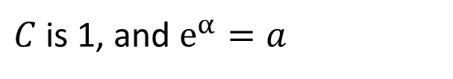

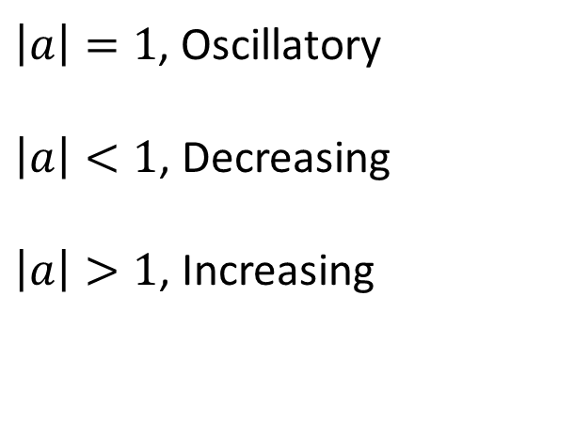

Exponential
$$Ce^{αn}$$
$C$ is 1, and $e^{α}=a$
$$a^{n}$$
$\left|a\right|=1$, Oscillatory
$\left|a\right|<1$, Decreasing
$\left|a\right|>1$, Increasing

Slide 10
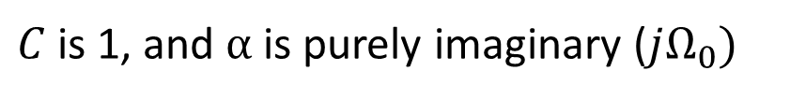
Exponential
$$Ce^{αn}$$
$C$ is 1, and $α$ is purely imaginary ($jΩ_{0})$
$$e^{j{(Ω}_{0}+2mπ)n}=e^{jΩ_{0}n}e^{j2mnπ}=e^{jΩ_{0}n}$$
Signal with frequency $Ω_{0}$ and signal with frequency $Ω_{0}+2mπ$ are the same.
Frequency wrapping.

Slide 11
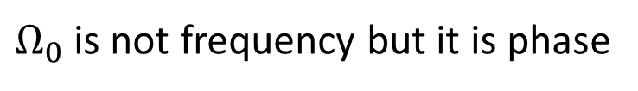

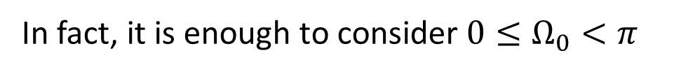
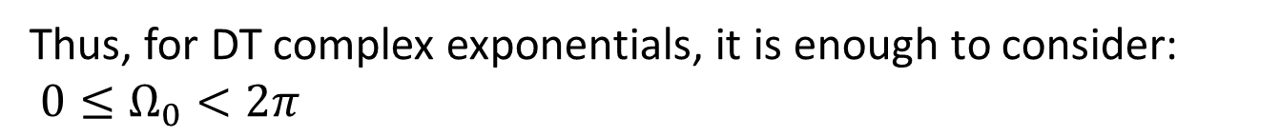
Exponential
Why frequency wrapping ?
$$e^{jΩ_{0}n}$$
$Ω_{0}$ is not frequency but it is phase
Thus, for DT complex exponentials, it is enough to consider:
$0≤Ω_{0}<2π$
In fact, it is enough to consider $0≤Ω_{0}<π$
{baseband frequencies}

Slide 12
System Properties

Slide 13
Outline of the Lecture
System Properties
  Memoryless
  Causal
  Invertible
  Stable
  Time invariant
  Linear
  Incrementally Linear

Slide 14


System
CT system
$$x(t)$$
$$y\left(t\right)$$

Slide 15


System
DT system
$$x[n]$$
$$y[n]$$

Slide 16
Outline of the Lecture
System Properties
  Memoryless
  Causal
  Invertible
  Stable
  Time invariant
  Linear
  Incrementally Linear

Slide 18
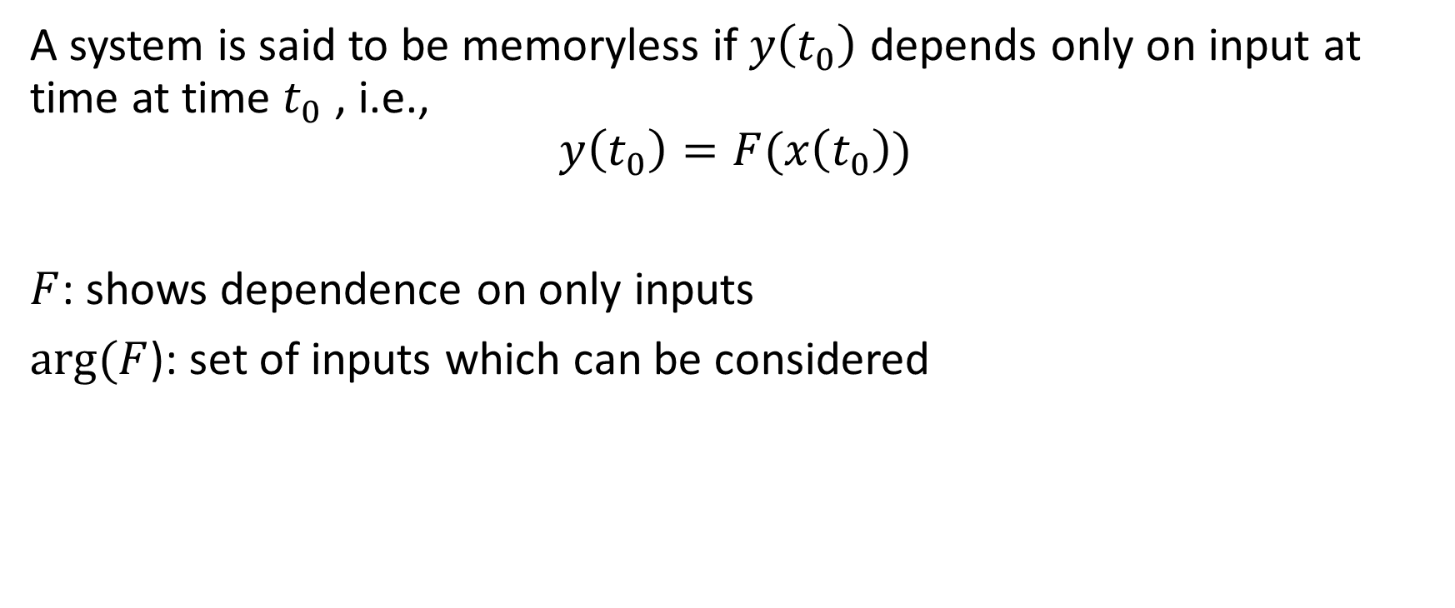
Memoryless
A system is said to be memoryless if $y\left(t_{0}\right)$ depends only on input at time at time $t_{0}$ , i.e.,
$$y\left(t_{0}\right)=F(x\left(t_{0}\right))$$
$F$: shows dependence on only inputs
$arg⁡(F$): set of inputs which can be considered

Slide 19
How many of them are memoryless systems?
A)
B)
C)
D)
NONE !!

